Slide 1

D.Y.PATIL COLLEGE OF ENGINEERING AND TECHNOLOGY KASABA BAWADA, KOLHAPUR
DEPARTMENT OF COMPUTER SCIENCE AND ENGINEERING
“ Classification of Brain Lesion and Grade Using MRI Texture and Shape in Machine Learning Scheme ”
Sr no. | Name | Roll no
1 | Jeet Aryan | 167
2 | Shivam Rajesh Mandlik | 168
3 | Vivek Vishwanath Patil | 169
Under the guidance of
Prof. Miss. A. R. Chougale

Slide 2
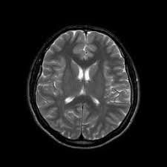
OVERVIEW
Introduction
Objective
Problem Statement
Proposed System
Methodology
Applications
Advantages
Technical Specifications
Results
Conclusion
References

Slide 3
INTRODUCTION
The human body is composed of numerous types of cells. Each cell has a specific function. These cells in the body grow and divide in an arranged manner and form some new cells.
When some of the cells lose their ability to control their growth, they grow without any order. The extra cells formed form a mass of tissue which is called tumor.
A brain tumor is a collection of abnormal cells in the brain. Tumors can be benign or malignant. Malignant tumors lead to cancer while benign tumors are not cancerous.
automated tumor detection methods are developed as it would save radiologist time. The MRI brain tumor detection is complex task due to complexity and variant of tumors. Tumor is identified in brain MRI using Machine Learning algorithms.
The proposed work is divided into three sections: Preprocessing steps are applied on the brain MRI images, then texture features are extracted using Gray Level Co-occurrence Matrix (GLCM) and finally classification is performed using machine learning algorithm.

Slide 4
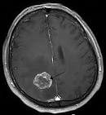
OBJECTIVE
To capture MRI images to analyse the presence of tumor using machine learning techniques.
To perform segmentation process on MRI images to separate the tumor from normal brain tissues.
To extract features from captured images to find the tumor.
To detect the presence of tumor.

Slide 5
PROBLEM STATEMENT In the medical field, Tumor is detected by Doctors by referring the MRI images which is very time consuming. Therefore, to overcome this problem, an alternative way is to design the system that will automatically identify the presence of Tumor in MRI images using machine learning technique and also provide faster and accurate solutions.
To design and implement the system which will predict the Brain Abnormalities using MRI images and Detection and Classify through Machine Learning Techniques.

Slide 6
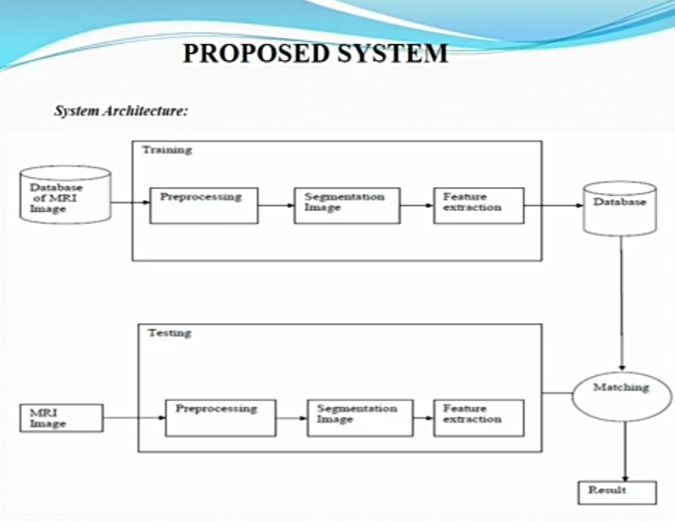

Slide 7
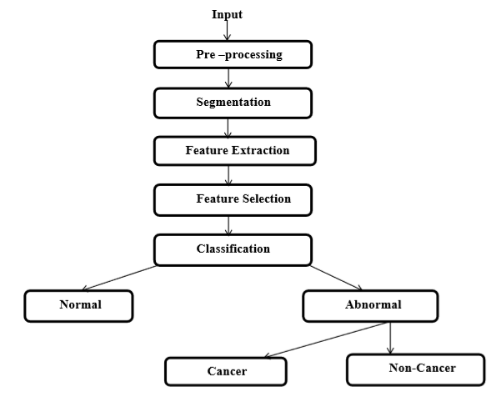
PROPOSED SYSTEM ARCHITECTURE
Fig: Classification Architecture

Slide 8
METHODOLOGY Modules : Methodology is a strictly defined combination of logically related practices methods processes that determine how best to plan develop control and deliver a project throughout the continuous implementation process until successful completion and termination. Module 1:- MRI Image Acquisition Module 2:- Preprocessing Module 3:- Segmentation Module 4:- Feature extraction Module 5:- Classification

Slide 9
MODULE 1:- Image Acquisition
Firstly, the MRI images are acquired and then these images are given as input to the pre-processing stage.
MODULE 2:- Preprocessing
Preprocessing is required as it improvises the image data which enhances some of the image features that are important for the further processing.
The RGB MRI image is converted to gray scale image and the median filter is applied to brain MR images for noise removal. The noise has to be removed for further processing as high accuracy is required.
The edges are detected from filtered image using canny edge detection. The detected image of the edges are required for segmentation of the image.
Further, Watershed segmentation is performed for finding the location of the tumor in the brain image

Slide 10
MODULE 3:- Segmentation
Segmentation is the process of dividing an image into multiple segments.
The aim of segmentation is to change the representation of a image into something which is easier to analyse.
Segmentation is the process of separating the tumor from normal brain tissues.
Watershed segmentation is performed for finding the location of the tumor in the MRI images.
The result of watershed segmentation is label image. In label image, the different objects that are identified will have different pixel values.

Slide 11
MODULE 4:- Feature Extraction
Transformation of the input data into a set of features is called feature extraction. In this step, the important features required for image classification are extracted.
The segmented brain MRI image is used and texture features are extracted from the segmented image which shows the texture property of the image.
These features are extracted using Gray Level Co-occurrence Matrix (GLCM) as it is robust method with high performance.
This texture feature extraction method is very competitive as using smaller number of gray levels shrinks the size of GLCM which reduces the computational cost of the algorithm and also maintains the high classification rates. These features are used to differentiate between normal and abnormal brain.

Slide 12
The GLCM texture features that are extracted are as follows:
Energy: It gives a measure of textural uniformity, that is, measure of pixel pair repetitions. Range=[0,1]
Contrast: It gives a measure of intensity contrast between a pixel and its neighbor over the whole image. Range-[0,1]
Correlation: It gives a measure of how correlated a pixel to its neighbor over the whole image. Range=[-1,1]
Homogeneity: It gives a measure of closeness of distribution of elements in GLCM to GLCM diagonal. Range-[0,1]

Slide 13
MODULE 5:- Classification
Classification of MR brain image either as normal or abnormal.
In MLP, each node is a neuron with a nonlinear activation function.
With the help of above modules we can detect weather the Tumor is present or not.
This process helps in identifying the size, shape and position of the tumor.

Slide 14
ADVANTAGES Combination of various function in one application:
This application provides features that would be used for various tasks. Other application could consume more memory from the computer but this application can bring images from server and useless memory of computer.
Also this application can generate better and accurate outputs.
User friendly interface:
Many other application can have a complex interface but this application has a graphical represented user friendly interface which can reduce the time of the operator and a new user who wants to use this software. • A user can perform scans as well as comparisons on the software at ease.
Accuracy:
As the base of this program is a machine learning, a large number of data is collected from various hospitals or the CT scan of brain.
A huge library is generated over servers and it's regularly updated. This can guarantee accurate data reading and perfect representation of the sports or the whites which are reflected on the images to the image which is been uploaded by a user. Thus giving an accurate result.

Slide 15
TECHNICAL SPECIFICATION
Software Requirements
Windows: Python 3.6.2 or above,
PIP and NumPy 1.13.1,
OpenCV (Open source computer vision),
Keras,
Tensor Flow,
Jupyter Notebook Software:
Android Studio.
Hardware Requirements:
Processor: Intel core i5 or above. 64-bit, quad-core, 2.5 GHz minimum per core
Ram: 4 GB or more
Hard disk: 10 GB of available space or more.
Display: Dual XGA (1024 x 768) or higher resolution monitors
Operating system: Windows 10,11

Slide 16
APPLICATIONS
The main aim of the application is to identify tumor and diagnosis.
The main reason behind the development of this application is to provide proper treatment as soon as possible and protect the human life in danger.
This application is used for drug discovery and manufacturing.
This application is helpful for doctors as well as patients.
This application is used to do smart health care records.
The manual identification is not so fast, accurate and efficient, therefore to overcome these problems this application is designed.
This application is used to provide better Radiotherapy.
It is user friendly application.

Slide 17
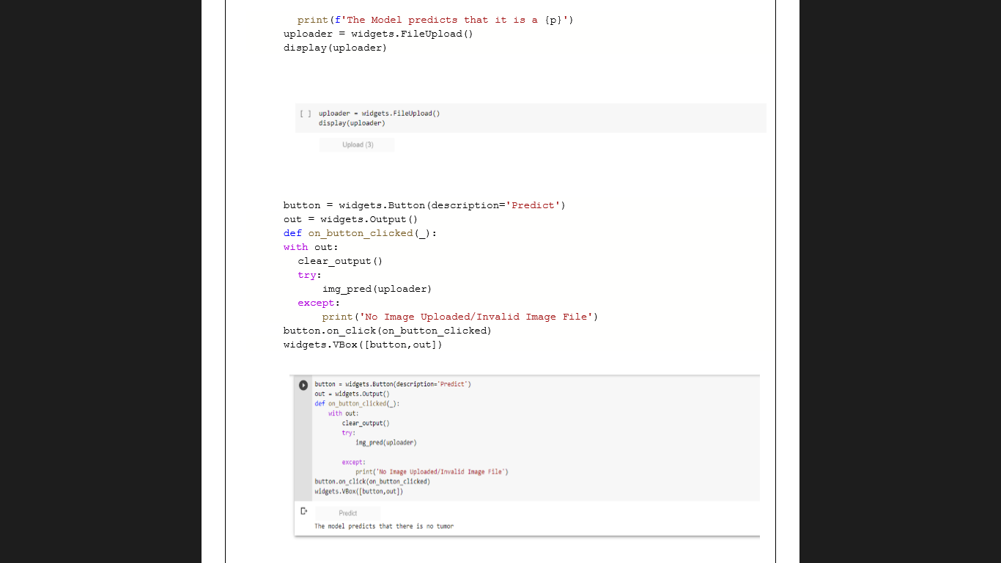
RESULTS

Slide 18
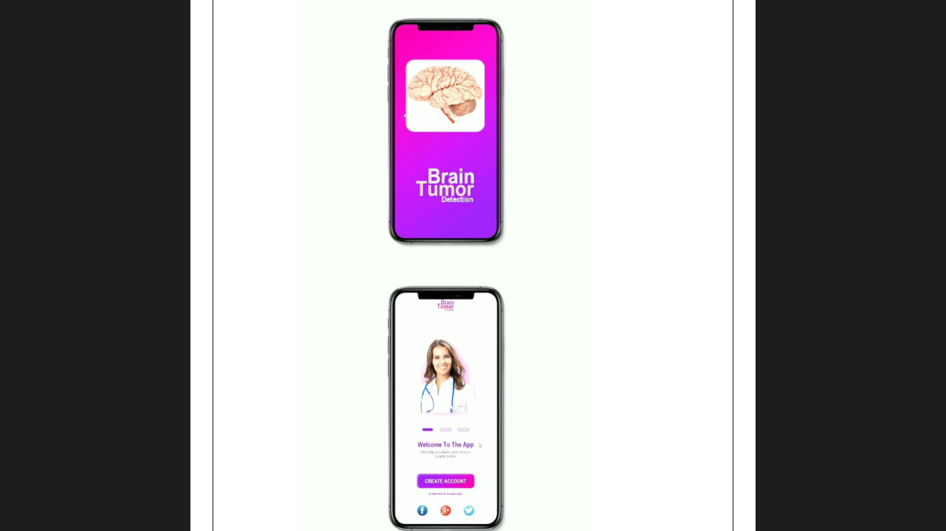
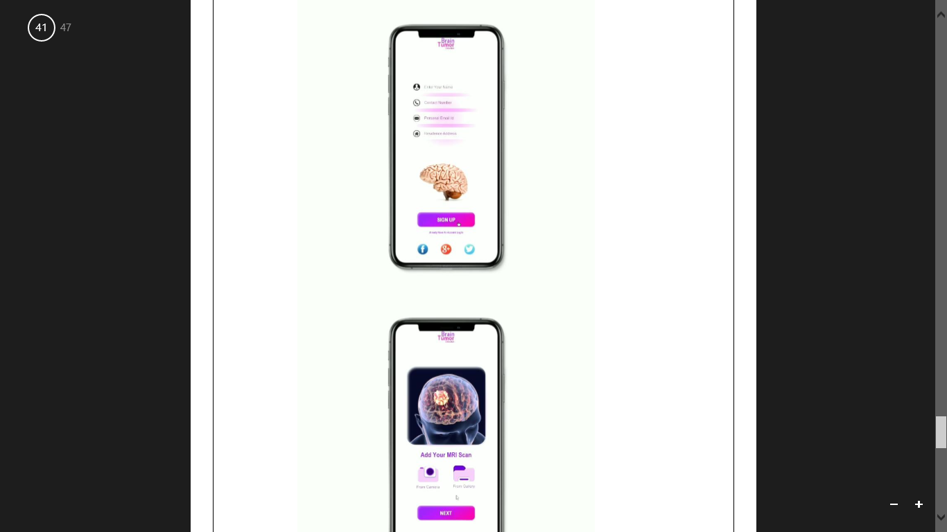
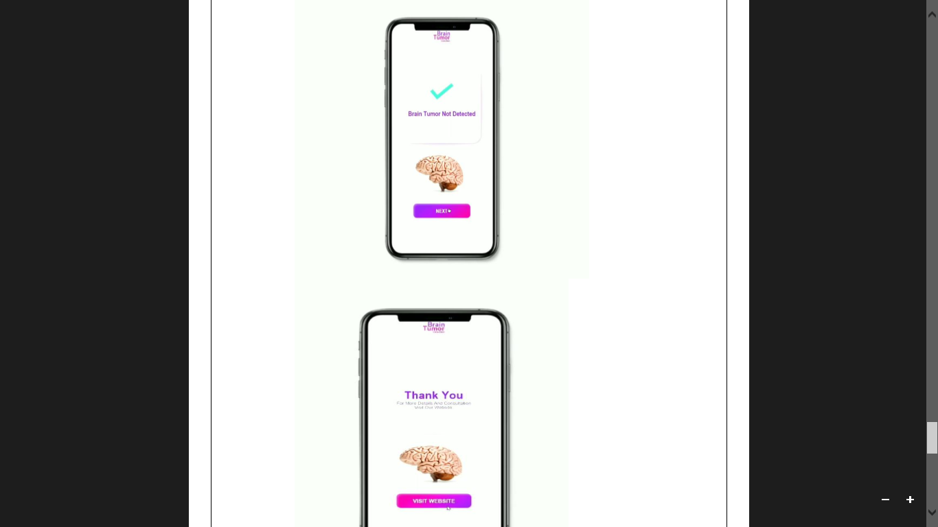

Slide 19
About The Application
It mainly involves 4 steps:-
Training and saving Tensorflow Model:- Firstly we need to train a model using Keras framework and save the model in .H5 or.PB format to load it any time we require.
Creating a TensorFlow Lite Converter:-The TensorFlow Lite converter is a tool available as a Python API that converts trained TensorFlow models into the TensorFlow Lite format. It can also introduce optimizations.
Converting TensorFlow Lite Converter into .tflite format:- Now we need to convert this object to tflite format which will be further used in the android application.
Deploying .tflite into Android Studio and run the Inference:- Now we will use Tensorflow Interpreter API in an android studio to run the .tflite model with data to produce output

Slide 20
CONCLUSION • In medical field, manual identification of brain tumor by doctors referring the MRI images is a very time consuming task and can be inappropriate for a large amount of data.. Instead of manual identification, image processing and machine learning techniques can be used to identify the tumor from the images. • Therefore, This model helps in understanding the creation of a system that will carry out image processing and identify the Brain Tumor using machine learning approach. And also show the location of the tumor in the highlighted area of the image.

